Slide 1
Annex to presentation “Clinker characteristics and burning behavior”
Condensation of circulating elements

Slide 2
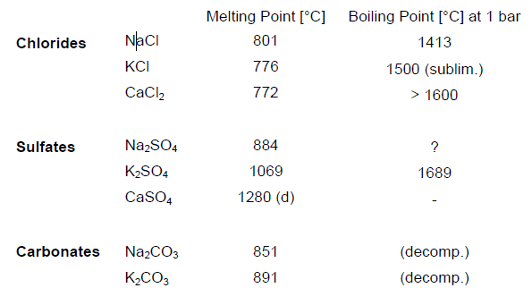
Condensation of circulating elements
Melting point and boiling point (at 1 bar) of some chlorides, sulfates and carbonates
Generally speaking it can be stated that the chlorides condense at lower
temperatures than the sulfates

Slide 3
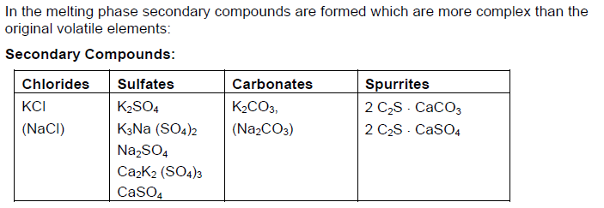
Condensation of circulating elements
Secondary Compounds forming in the melting phase

Slide 4
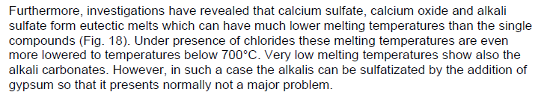
Condensation of circulating elements
Lowering of meting temperatures below 700°C

